Slide 1
Module 2.3 DATA LINK PROTOCOLS

Slide 2
Contents
Introduction
Data Link Layer Header
Simplex protocol
Stop and wait protocol (Error free channel)
Stop and wait protocol (Noisy channel)
Sliding WIndow Protocol
Go Back N protocol
Selective Repeat Protocol

Slide 3
2.0 Introduction
The Data Link layer exists as a connecting layer between the software processes of the layers above it and the Physical layer below it (Fig.a)
It prepares the Network layer packets for transmission across some form of media, be it copper, fiber, or the atmosphere.
Data Link layer is embodied as a physical entity, such as an Ethernet network interface card (NIC), which inserts into the system bus of a computer and makes the connection between running software processes on the computer and physical media.
Software associated with the NIC enables it to prepare data for transmission and encode it as signal to be sent on the associated media

Slide 4
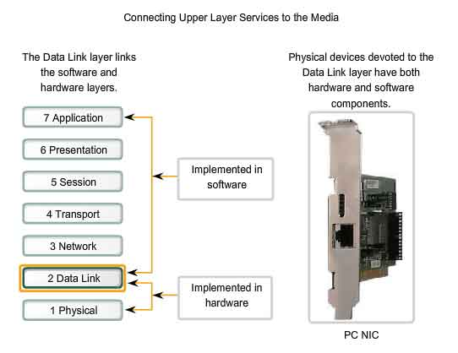
Fig. a

Slide 5
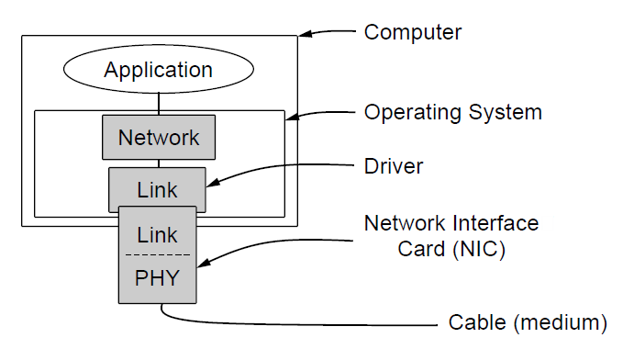
2.0 Introduction
Goal of DLL is to provide error free & transparent communication between network layer processes
We assume physical, data link and network layer are independent processes
Physical layer process and few data link layer process run on NICs
Remaining link layer and network layer processes run on main CPU as part of OS
Software for the link layer process takes form of device driver

Slide 6
2.1 Utopian Simplex Protocol
Unrealistic protocol because:
It does not worry about the possibility of anything going wrong
Unidirectional protocol
Transmitting and receiving layers are always ready; processing time is insignificant
Infinite buffer space
Communication channel never breaks down or loses data

Slide 7
Utopian Simplex Protocol
Protocol consists of two procedures: sender and receiver
Both run in data link layer of source and destination machines respectively
No sequence numbers or acknowledgements are used
Only frame_arrival event type is used to indicate arrival of undamaged frame
Sender is in infinite while loop pumping data out onto the channel as fast as possible
Loop consists of three actions:
Fetch a packet from network layer
Construct an outbound frame using variable s
Send frame on it way
Only info field is used for the protocol

Slide 8
Utopian Simplex Protocol
At receiver side, it waits for an undamaged frame to arrive
When the frame arrives, procedure “wait_for_event” returns and event is set at “frame arrival”
The call to “from_physical_layer” removes the newly arrived frame from the hardware buffer and puts it in variable r
Then the data is passed on to the network layer
Data link layer settles back waiting for next frame

Slide 9
2.2 Stop and wait protocol (Error free channel)
Communication channel is assumed to be error free
Data traffic is considered to be simplex
It only tackles the problem of preventing the sender from flooding the receiver with frames faster than receiver is able to process them
Two ways to solve the problem of flooding:
Build a receiver powerful enough to process a continuous stream of back to back frames:
Needs sufficient buffering and processing abilities
Needs dedicated hardware
Resources can be of no use if utilization of link is low most of the time
Receiver sends feedback
Receiver sends a dummy frame (acknowledgement) to the sender after sending the packet to network layer; giving permission to sender to transmit next packet

Slide 10
Stop and wait protocol (Error free channel)
Protocols in which sender sends one frame and then waits for an acknowledgement before proceeding are stop and wait protocol
Communication between sender and receiver is bi directional
Only sender or receiver can send a frame at one time, half duplex connection is formed
Sending data link layer need not check incoming frame as it will be an acknowledgement always

Slide 11
2.3 Stop and wait protocol (Noisy channel)
Communication channel is not assumed to be error free
Frames may be damaged or lost during transmission (Fig.a)
This protocol assumes that if a frame is damaged, receiver hardware will detect it while compiling checksum due to which no acknowledgement will be sent and after a time out sender will resend the frame
If a damaged frame gives correct checksum (unlikely occurrence), this protocol can fail (deliver incorrect packet)

Slide 12
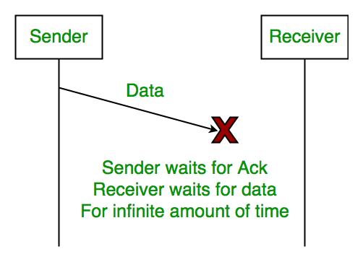
Fig. a

Slide 13
2.3.1 Stop and wait protocol scenario (Noisy channel)
Consider a scenario where machine A sends a series of packets to its data link layer which needs to be sent to network layer of machine B by its own data link layer
Network layer on machine B has no way of knowing if packet has been lost or duplicated
Hence data link layer must guarantee no combination of transmission errors take place

Slide 14
2.3.1 Stop and wait protocol scenario (Noisy channel)
In this scenario; consider following case:
Network layer on A gives packet 1 to its data link layer. Packet is received error free at B and passed on to its network layer
B sends acknowledgement frame to A but it gets lost (Fig. b)
Data link layer on A eventually times out. Not receiving an acknowledgement , it assumes its data frame was lost or damaged and resends it
Duplicate frame also arrives at B error free and is passed on to network layer
Thus, if A is sending a file to B, part of it will be duplicated and copy of the file at B will be incorrect

Slide 15
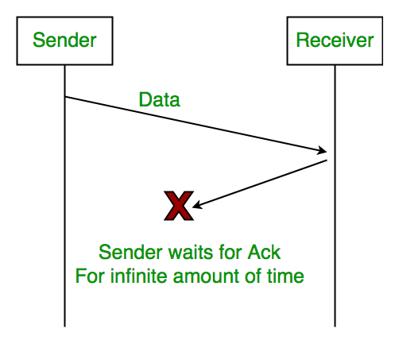
Fig. b

Slide 16
2.3.1 Stop and wait protocol scenario (Noisy channel)
To avoid this, receiver needs to be able to distinguish a frame from its retransmitted one
Solution for this is to add a sequence number in the header of each frame it sends
Receiver can check the sequence number and see if it is a new frame or a duplicated one
Number of bits assigned for the sequence number in the header should be minimum (1 bit is sufficient)
If sender sends a frame m and it is damaged or lost, receiver will not acknowledge it and sender keeps sending it again instead of its successor fram m+1
The ambiguity in this is, depending on reception of acknowledgement frame, sender sends either m or m+1 frame,

Slide 17
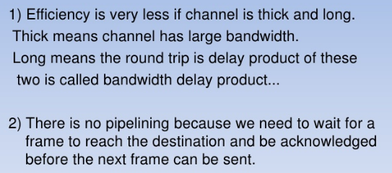
Disadvantages of Stop and Wait Protocol

Slide 18
2.3.1.1 AUTOMATIC REPEAT REQUEST (ARQ) PROTOCOL
In this, 1 bit sequence number is added in the header
At each instant of time, receiver expects a particular sequence number next
When a frame containing correct sequence number arrives, it is accepted and passed on to network layer and acknowledged
Then the expected sequence number is incremented modulo 2 (i.e. 0 becomes 1 and 1 becomes 0)
If a frame arrives with a wrong sequence number, it is rejected as a duplicate (Fig. c)
In this case, last valid acknowledgement is repeated for sender to discover which frame has been received

Slide 19
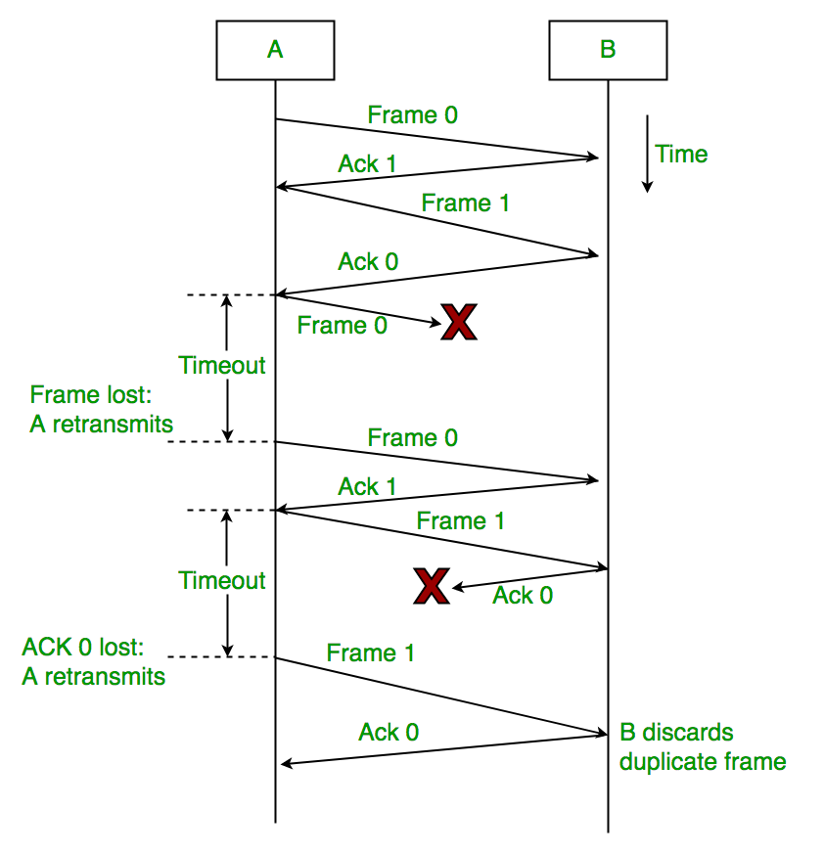
Fig. c

Slide 20
2.4 SLIDING WINDOW PROTOCOL
In previous protocols, frames were transmitted in one direction only
To achieve full duplex transmission, we can run two instances of previous protocols using a separate link with simplex transmission in different directions
Each link has a “FORWARD CHANNEL” for data and a “REVERSE CHANNEL” for acknowledgements
In both the links capacity of reverse channels is wasted completely
Hence , there was a need for a full duplex transmission using same link, which is sliding window protocol

Slide 21
2.4 SLIDING WINDOW PROTOCOL
In this protocol, data frames from A to B are intermixed with acknowledgement frames from A to B
Referring to the “kind” field in the header of an incoming frame, receiver can differentiate whether it is data or acknowledgement.
Hence, we INTERLEAVE data and control frames on the same link

Slide 22
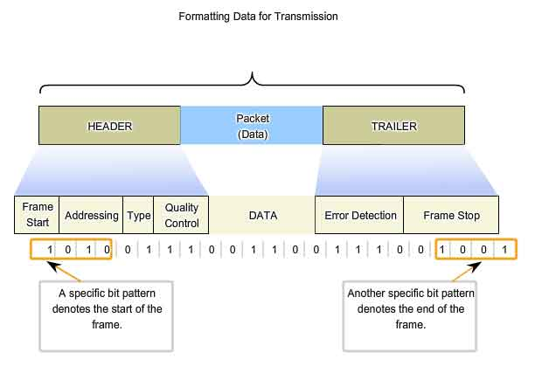
Data Link Layer Header

Slide 23
2.4 SLIDING WINDOW PROTOCOL
Another advantage is, when a data frame arrives, instead of sending a control frame immediately, receiver restrains itself till the next data frame is passed down from the network layer
Acknowledgement is attached to this next outgoing data frame, using the acknowledgement field in the header
Thus, acknowledgement gets a free ride with the outgoing data packet and no bandwidth is wasted
This technique of delaying acknowledgements temporarily so that they can be hooked to the next outgoing frame is known as PIGGYBACKING

Slide 24
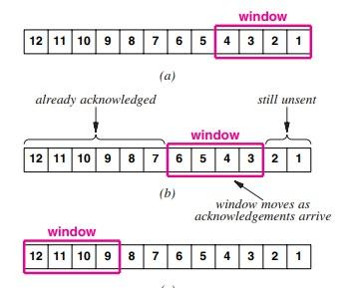

Slide 25
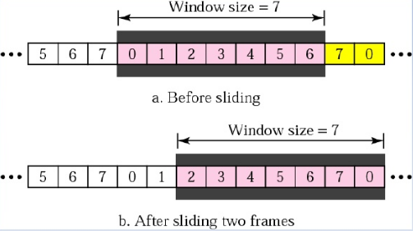
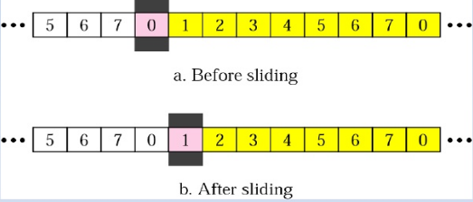
Sender Window & Receiver Window

Slide 26
2.4 SLIDING WINDOW PROTOCOL
Advantages:
Better use of available channel bandwidth
Number of frames sent is reduced
Thus reducing the processing load at the receiver
Disadvantages:
Wait time for data link layer to piggyback the acknowledgement is not known
If DLL waits longer than sender’s time out period, retransmission takes place thus duplicating the frame
Needs an ad-hoc system to wait a fixed amount of time to piggyback acknowledgement or else send it as a separate frame

Slide 27
2.4 TYPES OF SLIDING WINDOW PROTOCOL
There are three variations in Sliding Window Protocol
1 - bit sliding window
Go Back -N
Selective Repeat

Slide 28
2.4.1 1-BIT SLIDING WINDOW PROTOCOL
A sliding window protocol with window size 1 uses a stop and wait protocol indirectly because sender transmits one frame and waits for acknowledgement before sending the next one
Normally, one of the two data link layers goes first and transmits first frame
Starting machine collects data from its network layer, builds a frame and sends it
At the receiver, the frame is checked and is passed to the network layer and receiver’s window is slide up

Slide 29
2.4.1 1-BIT SLIDING WINDOW PROTOCOL
Steps for protocol:
Acknowledgement field contains the number of last frame received without error
If this number agrees with the sequence number of the frame the sender is trying to send, sender knows it is done with the frame stored in the buffer and can fetch the next packet
If the sequence number disagrees, it continues to send the same frame

Slide 30
2.4.1 1-BIT SLIDING WINDOW PROTOCOL – ISSUES
Consider computer A is trying to send frame A0 to computer B but A’s timeout interval is too short
In such a scenario, A will timeout repeatedly and send a series of identical frames all with Seq No 0 and Ack No 1
B will reject every duplicate frame and it will send A a frame with Seq No 0 and Ack No 0
Eventually A will send the correct packet
Protocol works correctly in this scenario but after a series of lost frames and timeouts

Slide 31
2.4.1 1-BIT SLIDING WINDOW PROTOCOL - ISSUES
Consider computer A and computer B both send an initial packet simultaneously
If B waits for A’s first frame before sending its own, sequence is as shown in fig. 3.4a
No duplicate packets arrive at any computer
In the fig. 3.4b, first frames of A and B cross at the data link layer
Half of the frames contain duplicates without any transmission errors causing waste of bandwidth

Slide 32
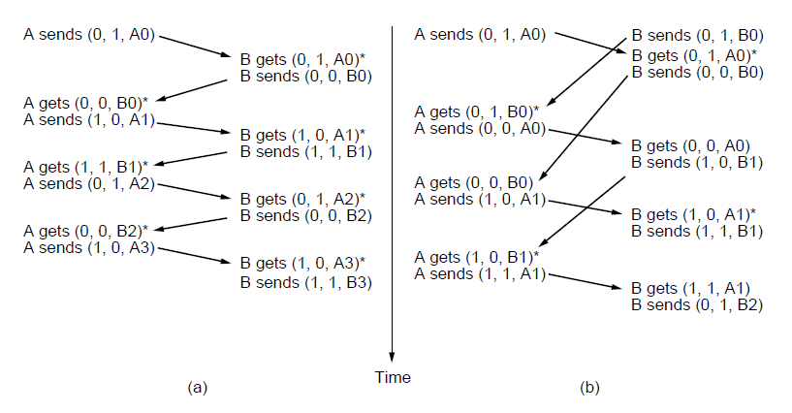
Fig. 3.4

Slide 33
2.4.2 GO BACK-N PROTOCOL
In this protocol, the sender can transmit up to a window of w frames before blocking transmission while waiting for acknowledgement
With large enough choice for w, sender will be able to continuously transmit frames since acknowledgements for previous frames will arrive before the window becomes full
To find correct value of w, we consider how many frames can fit in the channel as they propagate from sender to receiver

Slide 34
2.4.2 GO BACK-N PROTOCOL
w can be calculated as:
w = 2BD + 1
Where BD is Bandwidth-Delay Product given as:
= bandwidth * one way transit time
2BD is the number of frames that can be outstanding if the sender continuously sends frames when the round trip time to receive an acknowledgement is considered
1 is added because an acknowledgement frame will not be sent unless a complete frame is received

Slide 35
2.4.2 GO BACK-N PROTOCOL
(example of window size)
Consider a link with bandwidth 50 kbps and a one way transmit time as 250 msec
Thus, bandwidth delay product is 12.5kbit (50kbps*250msec) or 12.5 frames of 1000 bits each
In this case, w is = 2(12.5)+1 = 26 frames
Assume sender begins sending frame 0 and then sends a new frame every 20 msec
By the time 26 frames are sent, time lapsed is 520msec and acknowledgement for frame 0 will have just arrived

Slide 36
2.4.2 GO BACK-N PROTOCOL
(example of window size)
Thereafter, acknowledgements arrive every 20 msec
From then onwards, 26 unacknowledged frames will always be outstanding
For smaller window sizes for this example, utilization of the link will be less than 100% since the sender will be blocked sometimes.
Link utilization can be determined as:
Link utilization <= w / (2BD + 1)

Slide 37
2.4.2 GO BACK-N PROTOCOL (pipelining)
This technique of keeping multiple frames in flight is known as Pipelining
Pipelining frames over unreliable communication channel may result in lost or damaged frames at the receiver side.
Receiving data link layer hands frames in sequence to network layer.
If any one frame is damaged, it is supposed to be discarded but question arises for the correct frames following it.
There are two approaches in this scenario:
First option (w =1) is for receiver to discard all subsequent frames and no acknowledgement be sent for those frames
The sender will timeout and retransmit all unacknowledged frames in order starting with damaged one

Slide 38
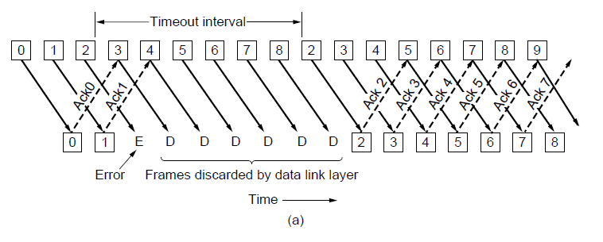
2.4.2 GO BACK-N PROTOCOL (Pipelining)

Slide 39
2.4.2 GO BACK-N PROTOCOL (Pipelining)
In the first option, DLL refuses to accept any frame other than the next one
In the second option (w >> 1); (fig. b)
Sender continues to send frames until the timer for damaged or lost frame is expired.
As the timer expires, it backs up to the damaged frame and resends all the frames following it.

Slide 40
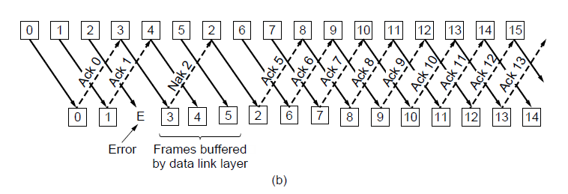
2.4.2 GO BACK-N PROTOCOL (Pipelining)

Slide 41
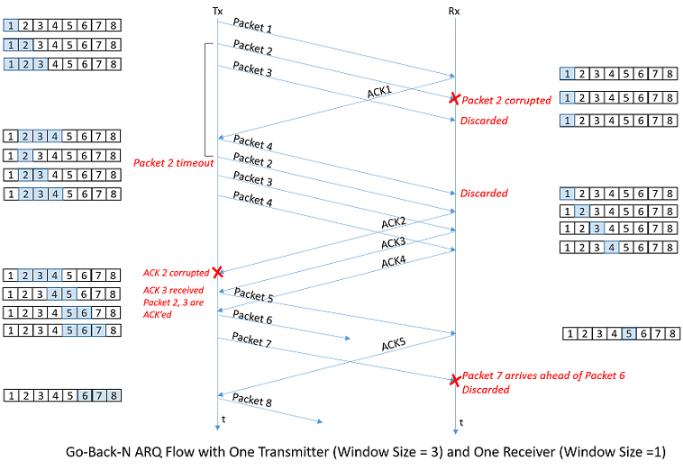
2.4.2 GO BACK-N PROTOCOL

Slide 42
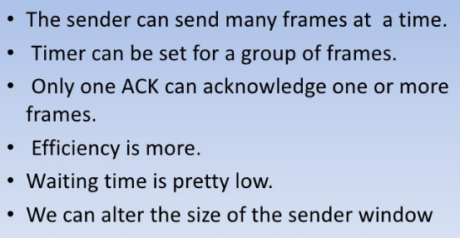
Advantages of Go back N ARQ

Slide 43
2.4.2 GO BACK-N PROTOCOL (Issues)
Works when errors are rare
If connection is unreliable, bandwidth is wasted on retransmission of frames
No buffer is applied to the frames received after a damaged or lost frame
Multiple timers are needed; one for each frame

Slide 44
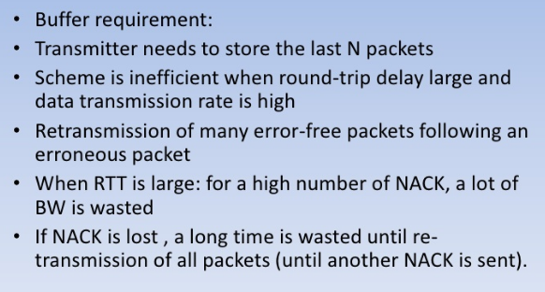
Disadvantages of Go back N ARQ

Slide 45
2.4.3 SELECTIVE REPEAT PROTOCOL
Why Selective Repeat Protocol?
The go-back-n protocol works well if errors are less, but if the line is poor it wastes a lot of bandwidth on retransmitted frames. An alternative strategy, the selective repeat protocol, is to allow the receiver to accept and buffer the frames following a damaged or lost one.
Selective Repeat attempts to retransmit only those packets that are actually lost (due to errors) :
Receiver must be able to accept packets out of order.
Since receiver must release packets to higher layer in order, the receiver must be able to buffer some packets.

Slide 46
2.4.3 SELECTIVE REPEAT PROTOCOL
In this protocol, sender and receiver both maintain a window of outstanding and acceptable sequence numbers respectively
Sender’s window starts from 0 and grows up to a predefined maximum number
Receiver’s window in contrast, is fixed and equal to predefined maximum
Receiver has a buffer reserved for each sequence number within its fixed window

Slide 47
2.4.3 SELECTIVE REPEAT PROTOCOL
When a frame arrives, its sequence number is checked by the function to see if it falls within the window
If so and it has not been received yet, it is accepted and stored
It is stored even if it is not the next packet expected by the network layer; it is kept in the DLL and not passed to network layer until all lower numbered frames are delivered to network layer
In Selective Repeat ARQ, the size of the sender and receiver window must be at most one-half of 2^m.

Slide 48
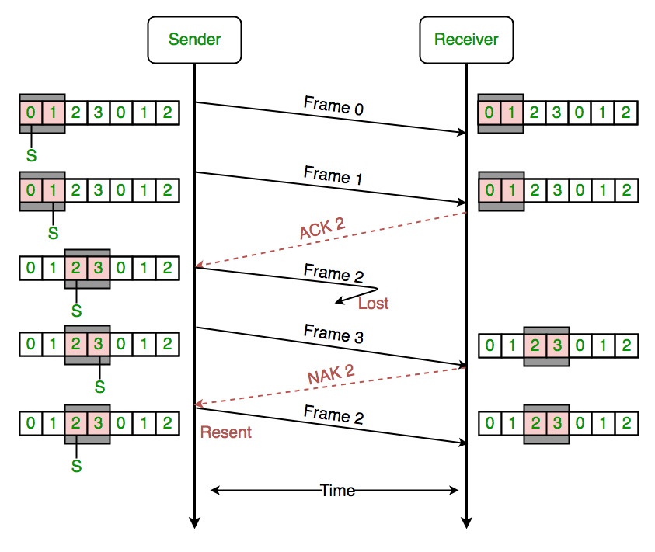
2.4.3 SELECTIVE REPEAT PROTOCOL

Slide 49
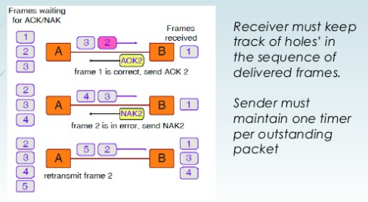
Example of Selective Repeat Protocol

Slide 50
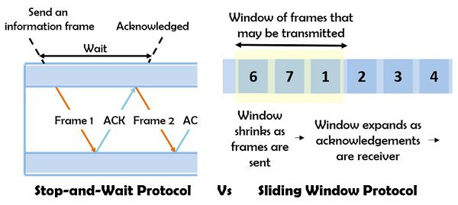
Comparison between Stop and wait and sliding window Protocol

Slide 51
Comparison between Stop and wait and sliding window Protocol
BASIS FOR COMPARISON | STOP-AND-WAIT PROTOCOL | SLIDING WINDOW PROTOCOL
Behaviour | Request and reply | Simultaneous transmit
Number of transferrable frames | Only one | Multiple
Efficiency | Less | More comparatively
Acknowledgement | Sent after each arriving packet | Window of acknowledgement is maintained
Type of transmission | Half duplex | Full duplex
Propagation delay | Long | Short
Link utilization | Poor | Better

Slide 52
Comparison between Go back-N and Selective Repeat
BASIS FOR COMPARISON | GO-BACK-N | SELECTIVE REPEAT
Basic | Retransmits all the frames that sent after the frame which suspects to be damaged or lost. | Retransmits only those frames that are suspected to lost or damaged.
Bandwidth Utilization | If error rate is high, it wastes a lot of bandwidth. | Comparatively less bandwidth is wasted in retransmitting.
Complexity | Less complicated. | More complex as it require to apply extra logic and sorting and storage, at sender and receiver.
Window size | N-1 | <= (N+1)/2

Slide 53
Comparison between Go back-N and Selective Repeat
Sorting | Sorting is neither required at sender side nor at receiver side. | Receiver must be able to sort as it has to maintain the sequence of the frames.
Storing | Receiver do not store the frames received after the damaged frame until the damaged frame is retransmitted. | Receiver stores the frames received after the damaged frame in the buffer until the damaged frame is replaced.
Searching | No searching of frame is required neither on sender side nor on receiver | The sender must be able to search and select only the requested frame.
ACK Numbers | NAK number refer to the next expected frame number. | NAK number refer to the frame lost.
Use | It more often used. | It is less in practice because of its complexity.

Slide 54
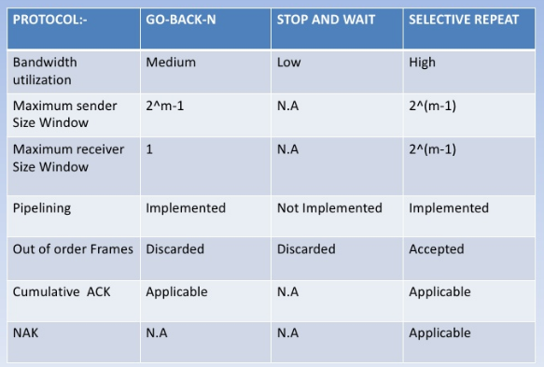
Comparison

